Slide 1
WELCOME TO THE TRIMBLE TECH BAND

Slide 2
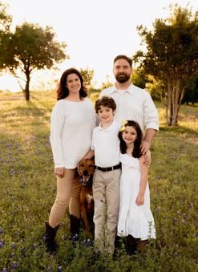
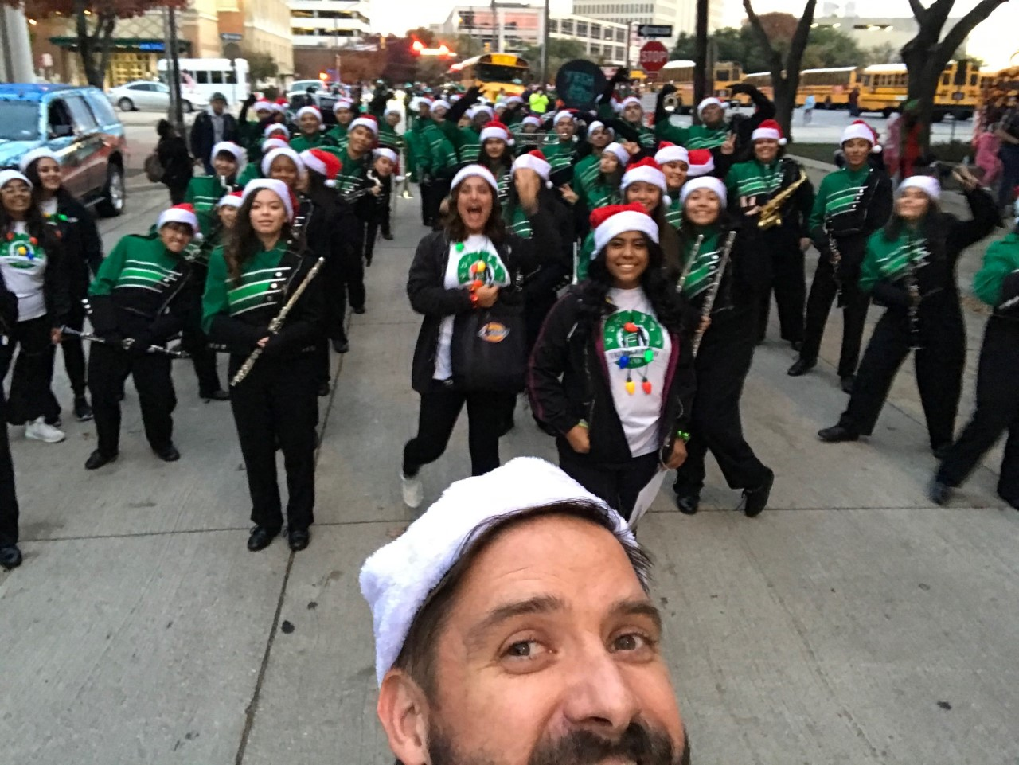
Mr. Belk

Slide 3
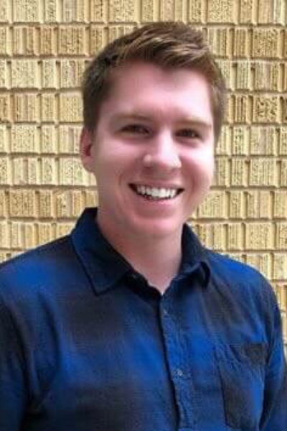
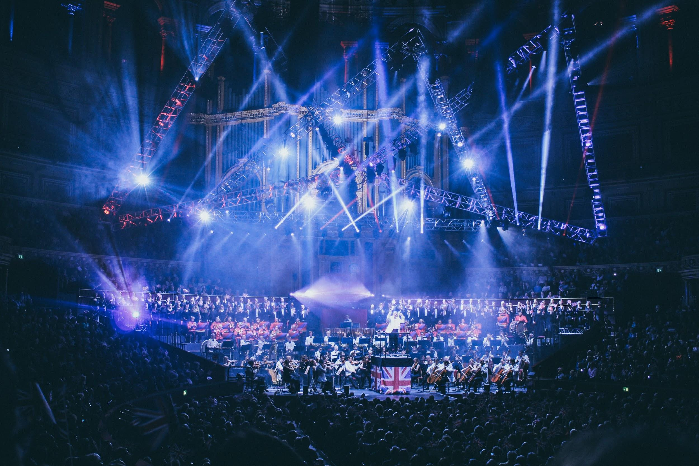
Mr. John Gaal

Slide 4
Show Promo
2021 SHOW REVEAL!!!

Slide 5
Why Band?
Goal: Create well-rounded musicians and good people by fostering positive relationships and experiences
Improves Education
Improves Character

Slide 6
Benefits
Know where your kids are; they’re supervised; and they’re with other great kids
Inherent values are taught, learned, and reinforced

Slide 7
Inherent Values
Time management
Teamwork - peer pressure to do well
Problem Solving
Relationship Skills - friends before starting high school
Family: Home-away-from home
Musicianship – the study of music positively impacts other academic pursuits

Slide 8
Schedule - What to Expect - Remainder of the Year
June 1 - 3rd: Audition Rehearsal Experience (5-7pm)
June 7-9th: Auditions (10-minute slot)
June 12th: Marching Registration Day (9am-4pm)
June 15th and 17th: 2021 Bulldog Band Rehearsals (5-7pm)
June 17th: Community/Parent Performance (6:30pm)
June 19th: Graduation Performance
www.tthsband.org

Slide 9
Schedule - What to Expect - Marching Season
July 26-August 6th (M-F): Band Camp #1+2 (8-5pm)
Morning: outside - Inside: afternoon
August 9-13th: Band Camp #3 (5-8pm); Community performance on the 13th
Band Calendar: www.tthsband.org
After-school rehearsals, 4-6pm, M-TH
Football games on Thursday or Friday
Sectionals: once/week in the morning before school
Season USUALLY ends first week of November

Slide 10
Schedule - What to Expect - Concert Season
Band is a year-long course
Sit-down band: Varsity, Non-Varsity, Sub-NonVarsity
Band Calendar is still SUPER IMPORTANT: www.tthsband.org
All-Region Music, UIL Concerts, Solos + Ensembles
After-school sectionals: once/week for a hour after school

Slide 11
Parent Volunteers
Band Boosters: www.tthsband.org
Chaperones, Medical Moms, Uniform Fitting, Fundraising, & Celebration Committee

Slide 12
Financial Commitment
$80 - Instrument Maintenance Fee:
District required fee
$100 - Fair Share Fee:
New Music
Contest Fees and Travel
Maintenance
Guest clinicians and marching instructors
$50 - Meal Fee:
$25 - Uniform Fee:
$10-$85 - Student Accessories:
Band shoes, gloves, show shirts, rehearsal shirt, water jug, fanny pack, poncho, and UDB app
Fundraising opportunities (required)
Fan Pledge - Telethon

Slide 13
Payment Plan
Option 1: Pay 1 payment of $255 + student accessories on June 12
Option 2: Pay For accessories + $25 In fair share fee then $40/month July through December.
$5 for late payments

Slide 14
Fundraising
Required for everyone
Raise money for a Fall Trip
Fan Pledge - August 11
Students can use part of money raised to help with band fee payments.

Slide 15
Communication
CHARMS
Website: www.tthsband.org
Email: jacob.belk@fwisd.org or john.gaal@fwisd.org or tthsband@gmail.com
Phone #
Worst Way: PORTAL

Slide 16
Questions?

